Slide 1
Linux Auditing with Security Content Automation Protocol (SCAP)
Steve Carter
August 20, 2016

Slide 2

About Me
Owner of Rampant Technologies
http://www.rampanttechnologies.com
Cybersecurity, Linux admin, Software development > 15 years
U.S. Government defense contractor > 13 years
CISSP, ISSAP, CEH

Slide 3
Overview
What
Why
How
Getting Started

Slide 4
What is SCAP?
“The Security Content Automation Protocol (SCAP) is a method for using specific standards to enable the automated vulnerability management, measurement, and policy compliance evaluation of systems deployed in an organization.”
-Wikipedia

Slide 5
What is SCAP?
Full Specification:
http://nvlpubs.nist.gov/nistpubs/Legacy/SP/nistspecialpublication800-126r2.pdf
Components of SCAP
Identification
Common Platform Enumeration (CPE)
Common Vulnerability Enumeration (CVE)
Common Configuration Enumeration (CCE)
Measurement & Scoring
Common Vulnerability Scoring System (CVSS)
Common Configuration Scoring System (CCSS)
Languages
eXtensible Configuration Checklist Description Format (XCCDF) ← TODAY’S FOCUS!
Open Vulnerability and Assessment Language (OVAL)
Open Checklist Interactive Language (OCIL)

Slide 6
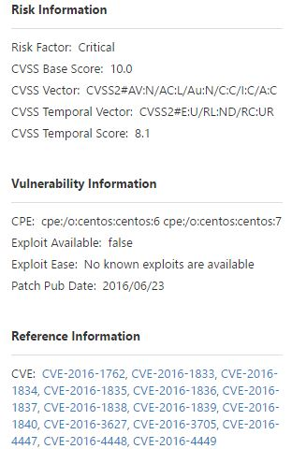
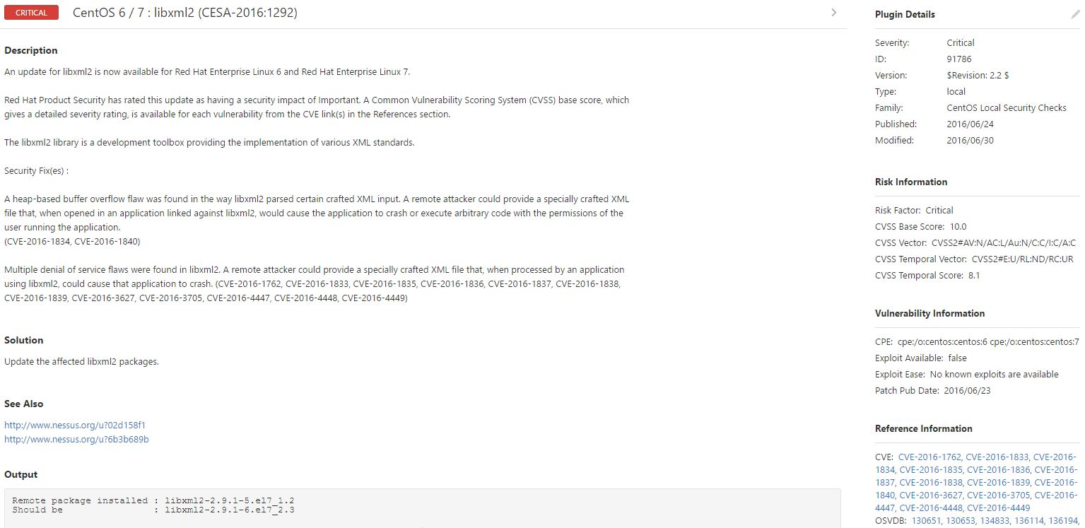
Why SCAP?
CVSS
Security vendors use SCAP
CVE

Slide 7
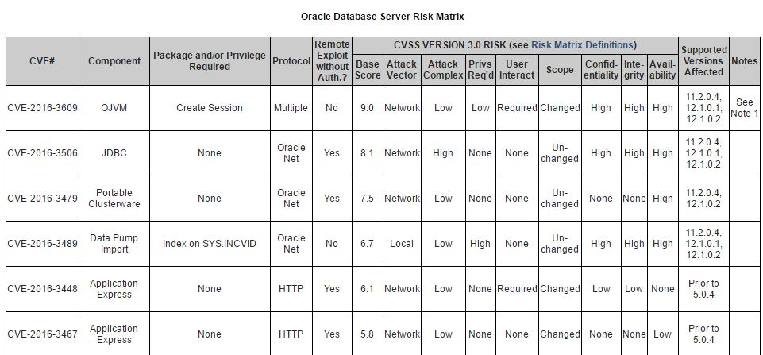
Why SCAP?
CVSS
COTS software vendors use SCAP
CVE

Slide 8
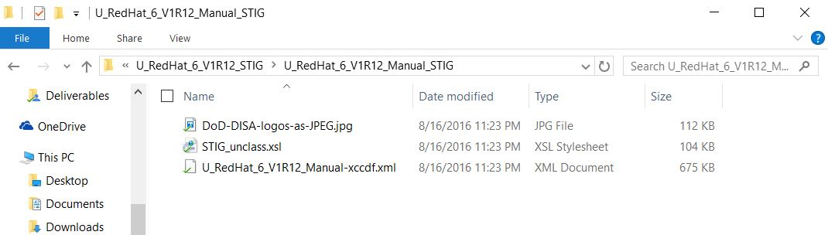
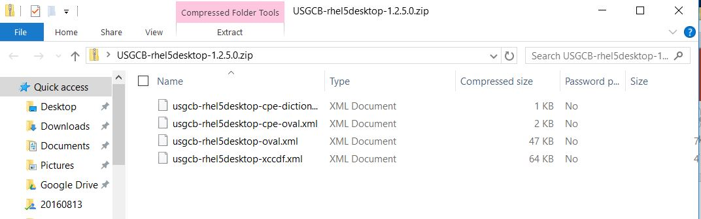
Why SCAP?
The U.S. Government uses SCAP
DISA STIGs and USGCB in XCCDF format

Slide 9
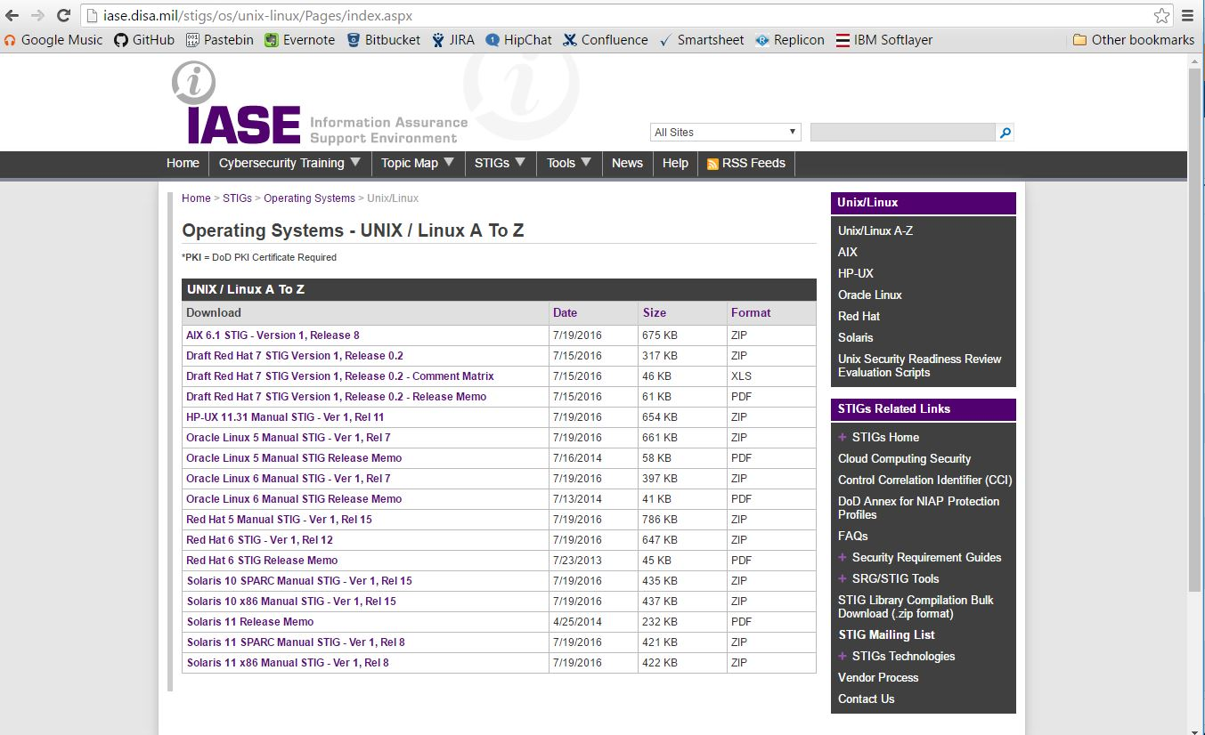
Getting Started
DISA STIGs for Linux
http://iase.disa.mil/stigs/Pages/stig-viewing-guidance.aspx
Notes:
yum install openscap-scanner
yum install scap-security-guide
yum install scap-workbench

Slide 10
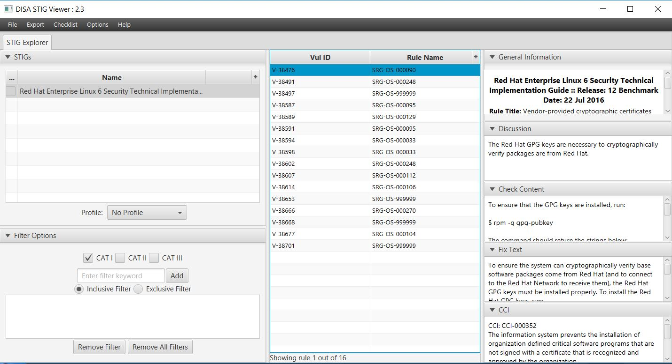
Getting Started
DISA STIG Viewer
http://iase.disa.mil/stigs/Pages/stig-viewing-guidance.aspx
Notes:
yum install openscap-scanner
yum install scap-security-guide
yum install scap-workbench

Slide 11
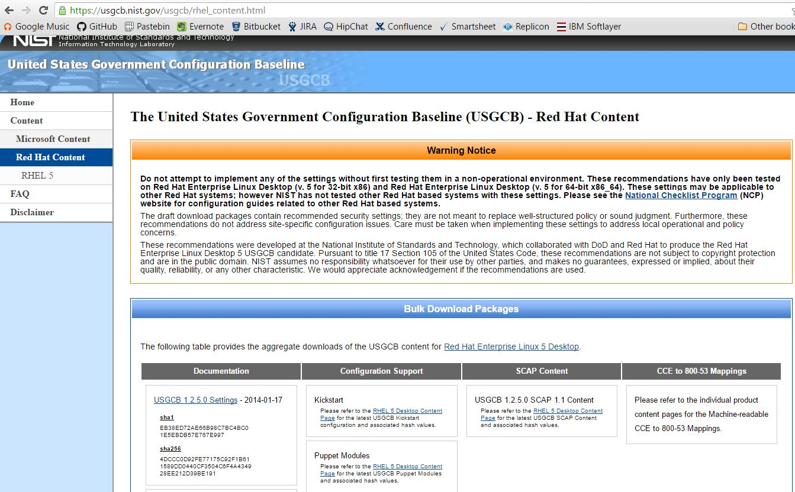
Getting Started
United States Government Configuration Baseline (USGCB)
https://usgcb.nist.gov/
Notes:
yum install openscap-scanner
yum install scap-security-guide
yum install scap-workbench

Slide 12
Getting Started
OpenSCAP (https://www.open-scap.org/)
Free and open source SCAP tools and content
OpenSCAP Base
Command line tool to ingest SCAP content and audit a system (“oscap”)
https://www.open-scap.org/tools/openscap-base/
# Yum install openscap-scanner
SCAP Security Guide
Combines DISA STIG and USGCB into one
Installs SCAP files for CentOS and RedHat in /usr/share/xml/scap/ssg/content/
https://www.open-scap.org/security-policies/scap-security-guide/
# yum install scap-security-guide
Notes:
yum install openscap-scanner
yum install scap-security-guide
yum install scap-workbench

Slide 13
Getting Started
Demo
Centos 6.8 on Digital Ocean
Not hardened (yet)

Slide 14
Other Resources
SCAP home page
https://scap.nist.gov
SCAP checklist repo
https://web.nvd.nist.gov/view/ncp/repository
Automated auditing the system using SCAP
https://access.redhat.com/blogs/766093/posts/1976103

